Slide 1


Adidas Sales Performance Overview
This presentation highlights Adidas sales data by region, product, and gender.
by Prashant Gupta

Slide 2
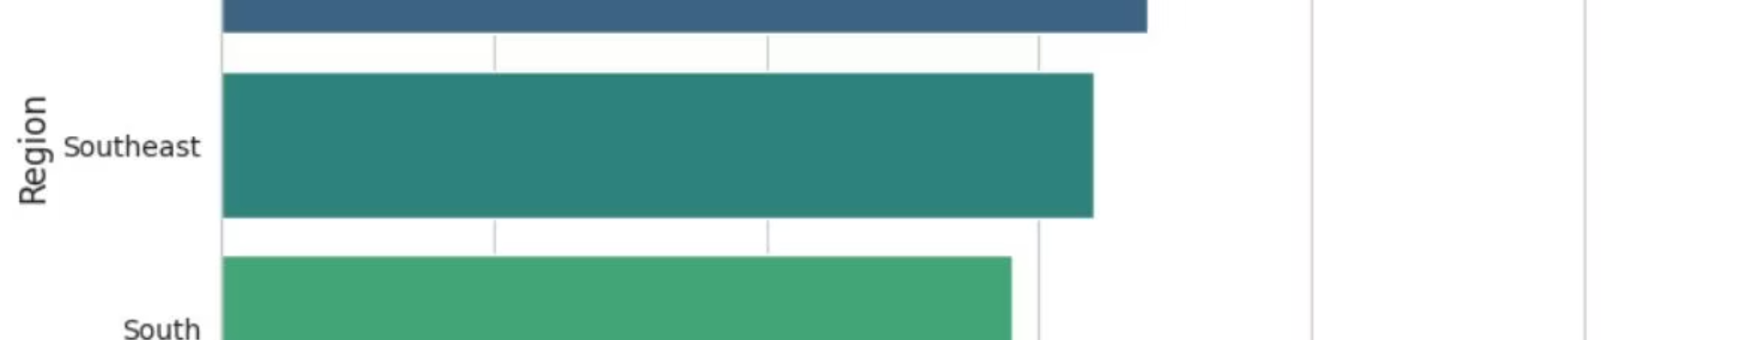
Total Sales by Region
West
Northeast
$270M in total sales, highest among regions.
$170M total sales, second highest region.
Southeast
South & Midwest
$160M total sales, close to Northeast.
South: $145M, Midwest: $140M total sales.

Slide 3
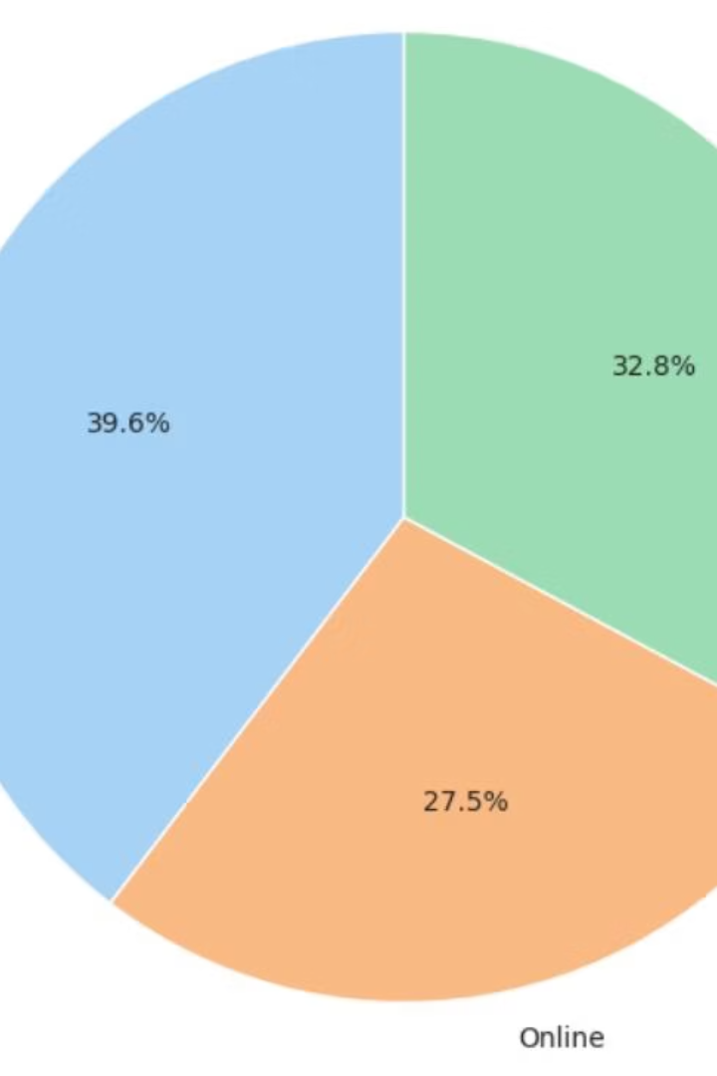
Sales Distribution by Method
In-store
Online
39.6% of sales come from in-store purchases.
27.5% of sales are online transactions.
Outlet
32.8% of sales occur through outlet stores.

Slide 4
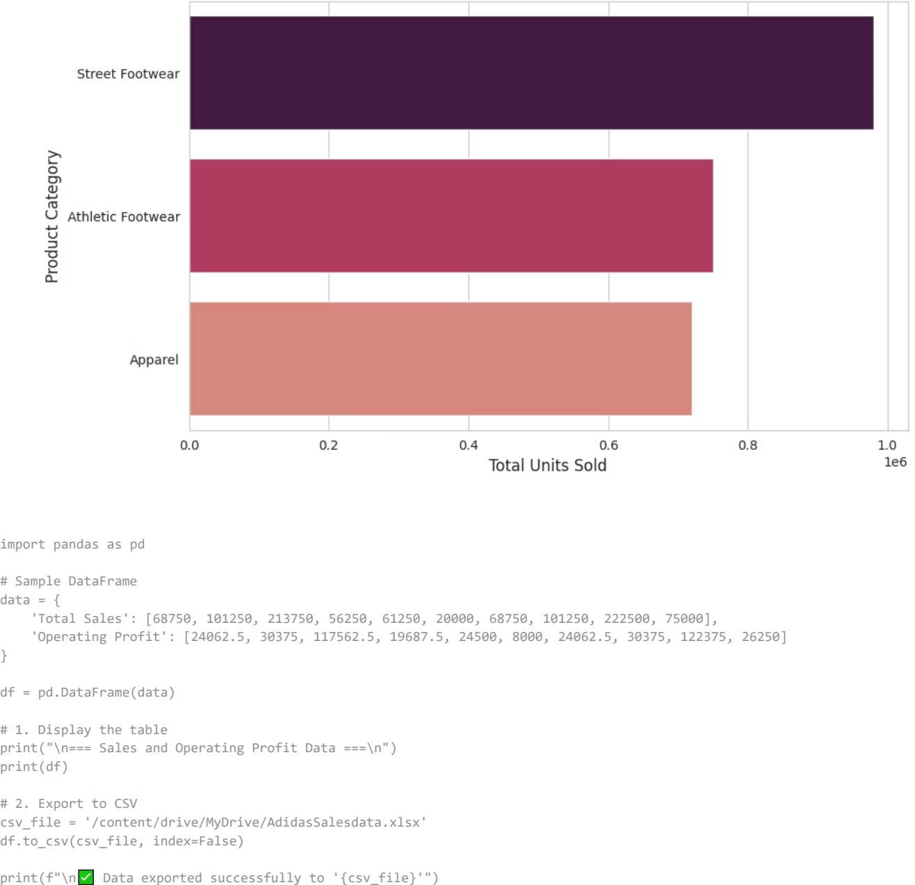
Units Sold by Product Category
Street Footwear
Athletic Footwear
Apparel
980,000 units sold, leading category.
750,000 units sold, second highest.
720,000 units sold, close third.

Slide 5
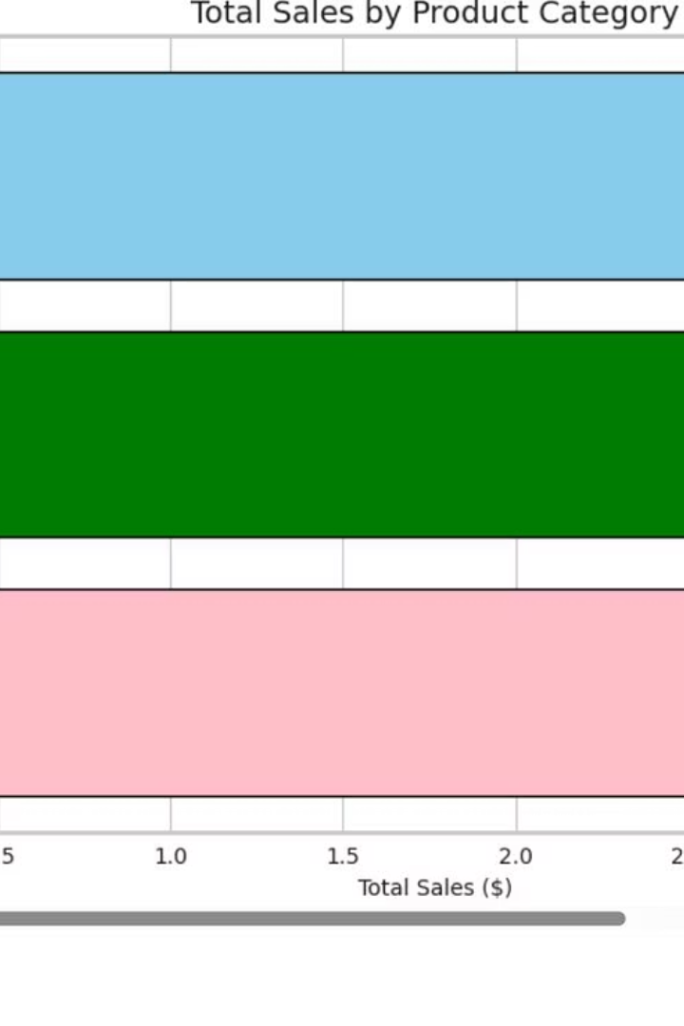
Total Sales by Product Category
Apparel
Street Footwear
$337M total sales, highest category.
$303M total sales, second place.
Athletic Footwear
$260M total sales, third highest.

Slide 6
Sales by Product Category and Gender
Men's Sales
Women's Sales
Street Footwear: $130K
Street Footwear: $80K
Athletic Footwear: $95K
Athletic Footwear: $70K
Apparel: $80K
Apparel: $110K

Slide 7
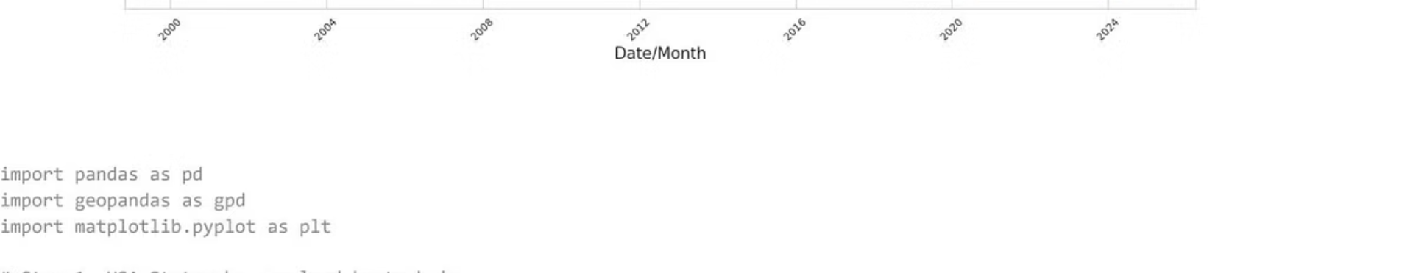
Sales Over Time by Gender and Product
Sales trends vary by gender and product category over time.

Slide 8

State-wise Performance Heatmap
This heatmap visualizes total sales performance across states.

